Slide 1
SUPPLY GUARD
GROUP A
SPRINT 5 PROJECT

Slide 2
Business Problem
SupplyGuard Logistics has large amounts of
customer, shipment and delivery data, but needs
better insight into its operational performance.

Slide 3
Customer Analysis
6th de

Slide 4
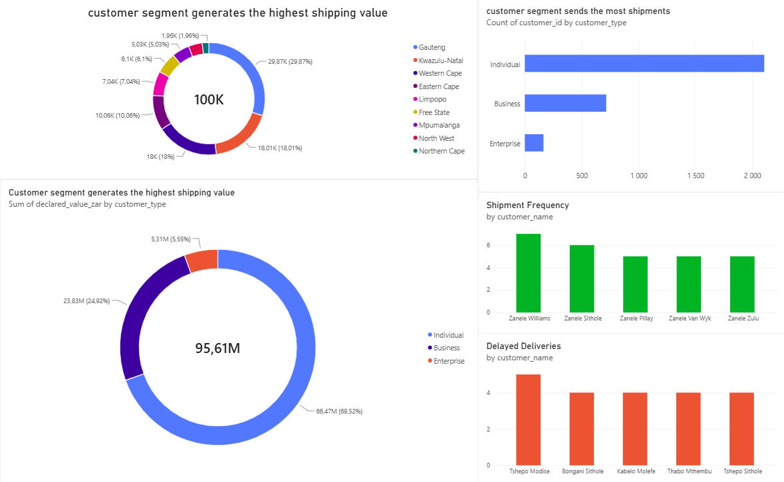

Slide 5
Shipment Analysis
6th de

Slide 6
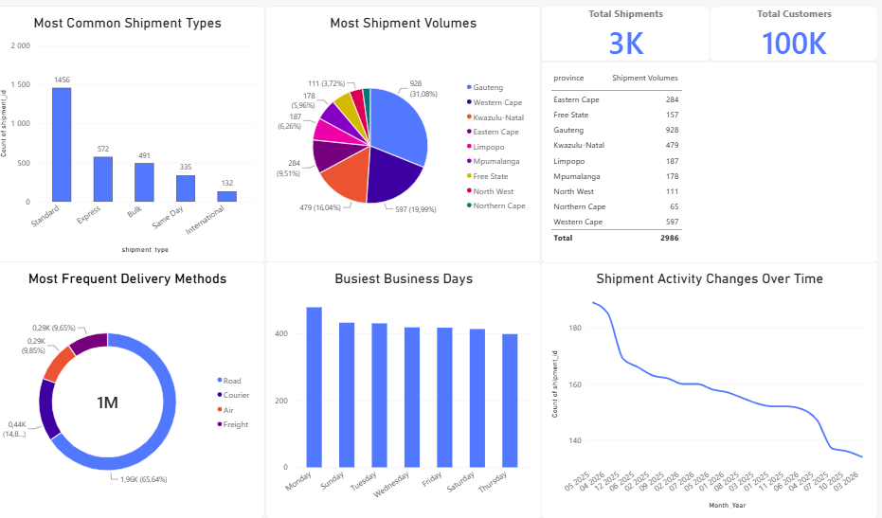

Slide 7
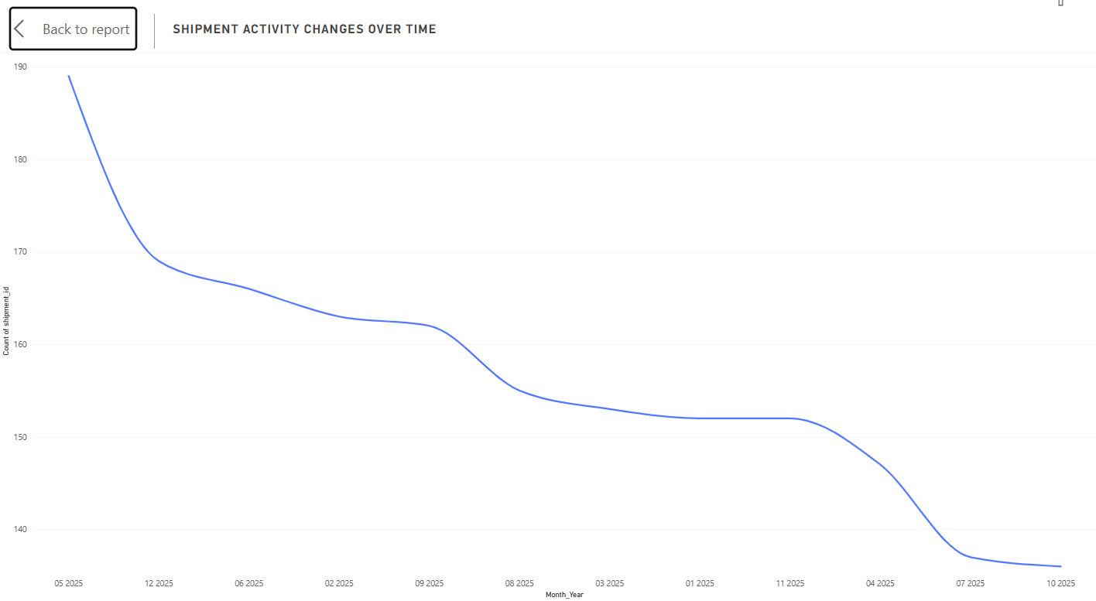
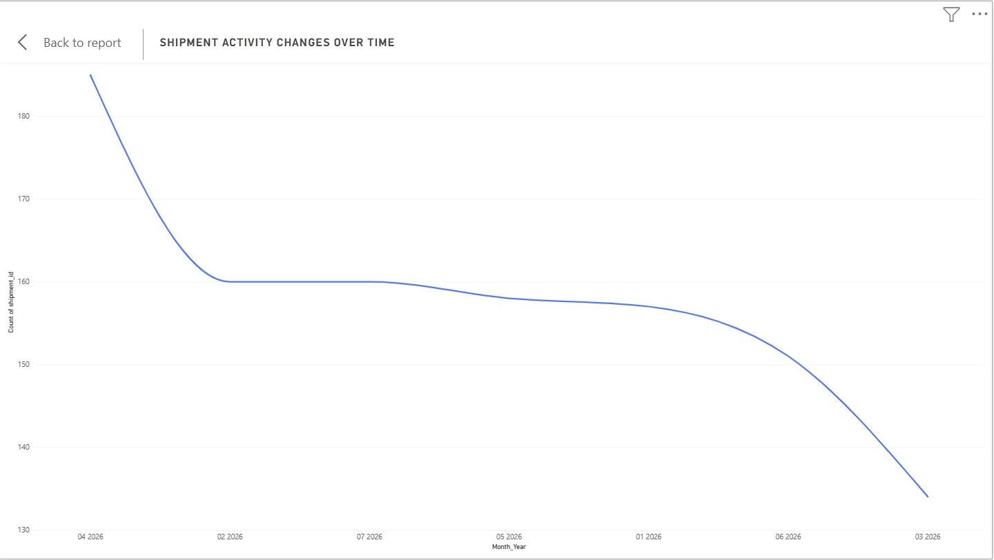
Shipment Volume Decreases
2025
2026

Slide 8
Delivery Analysis
6th de

Slide 9
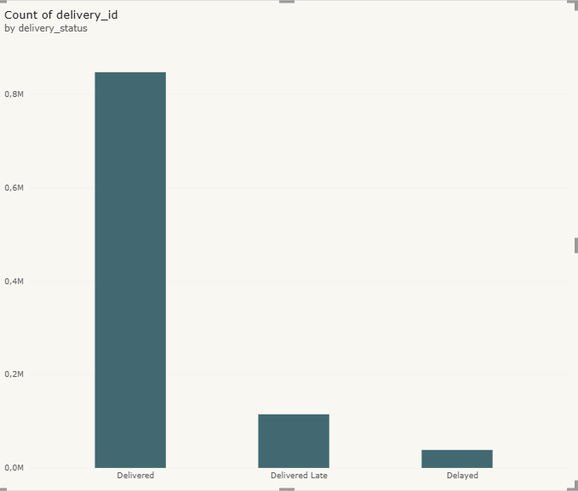
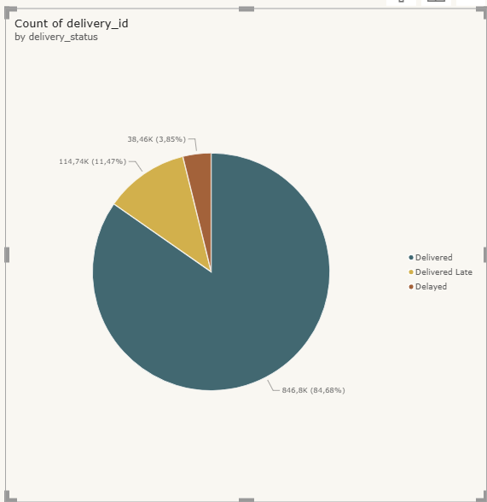
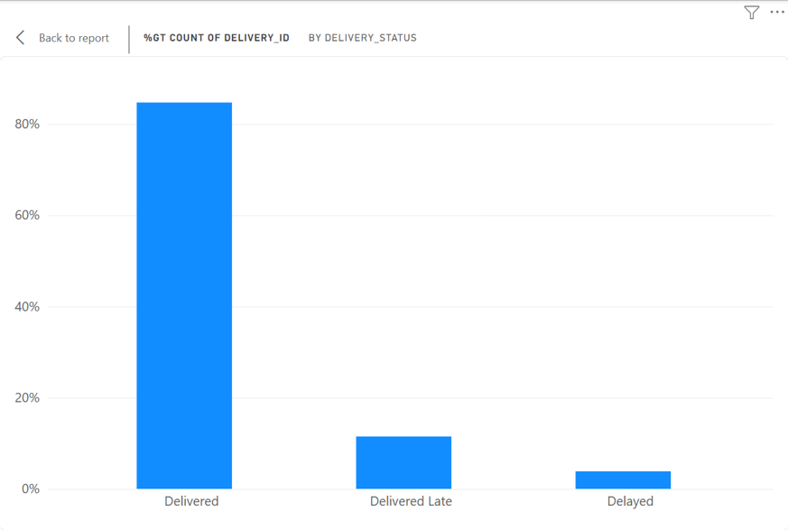
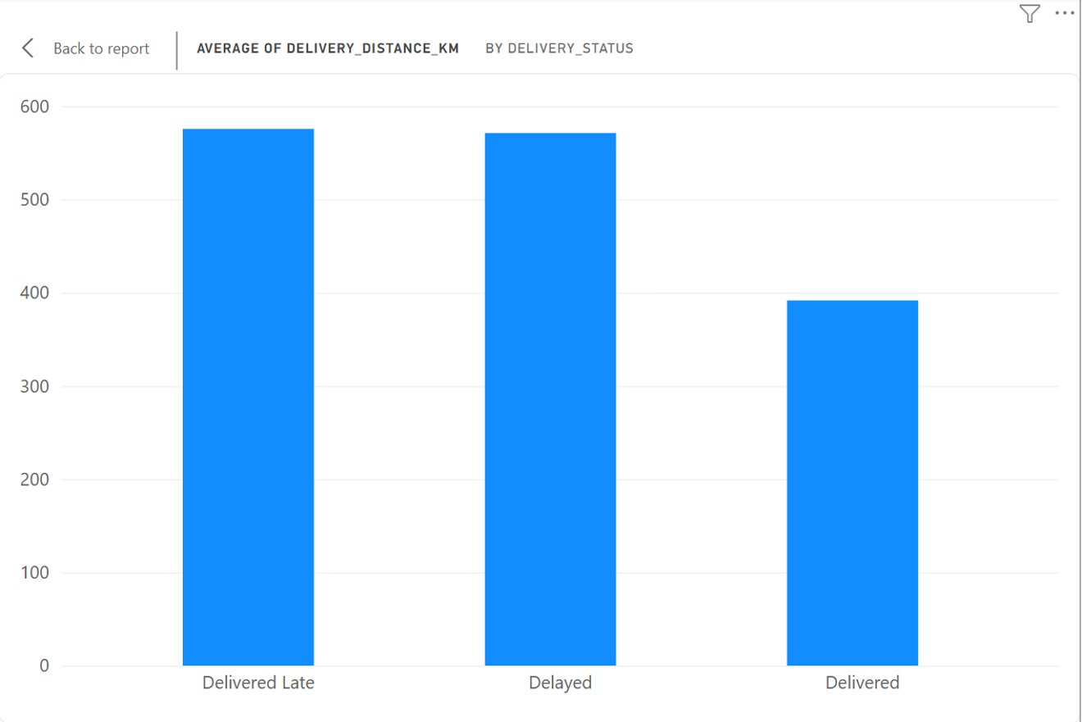
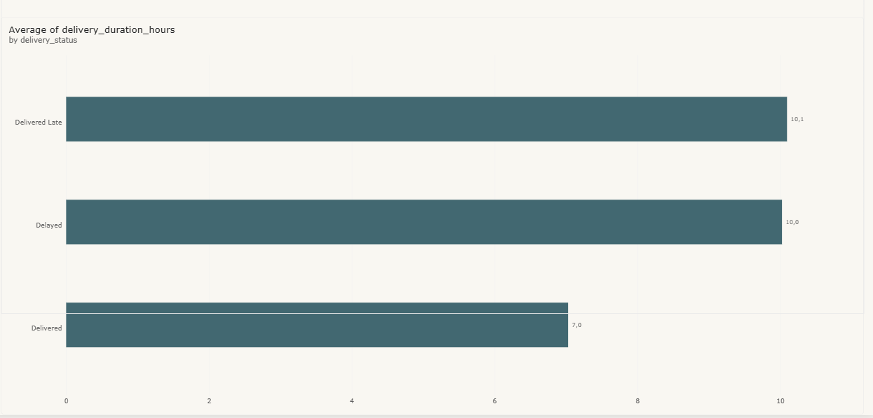
Delivery Status Distribution
Delivery Risk Analysis
Unusually Long Delivery Distances
Long delivery Durations

Slide 10
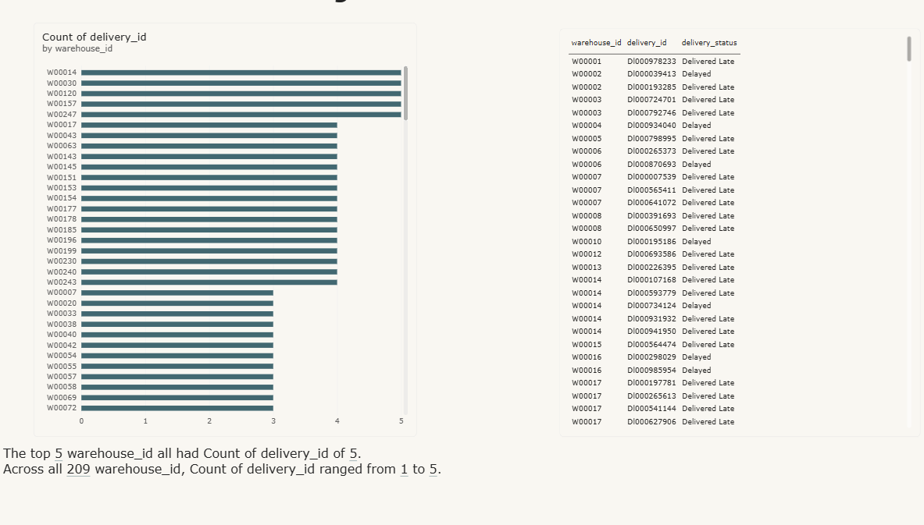
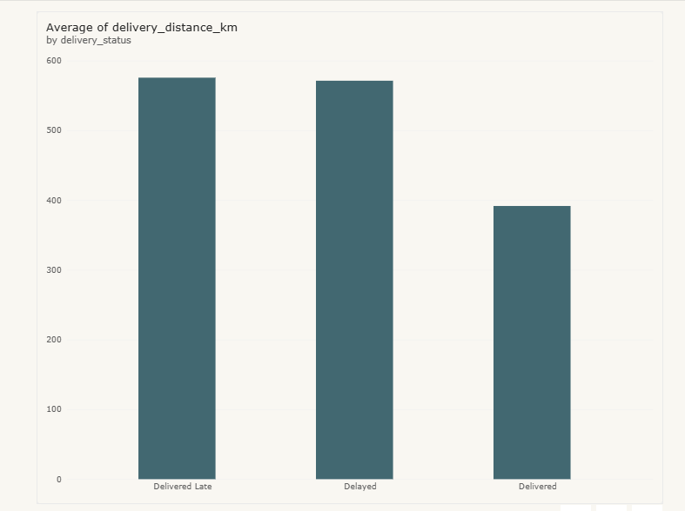
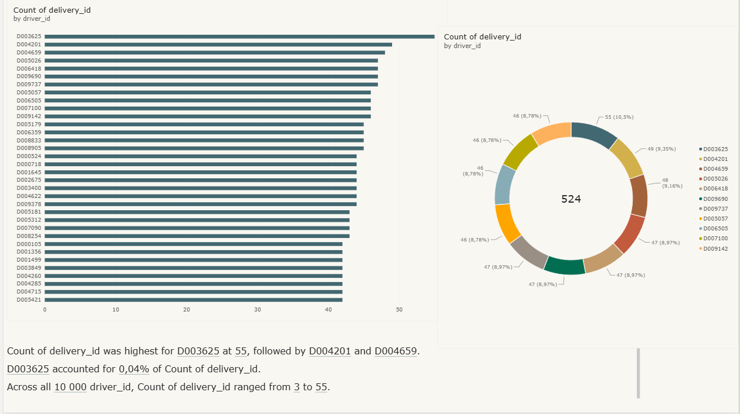
High Risk Warehouse
Driver Risk Analysis
Unusually long deliveries
Driver Risk Analysis

Slide 11
Delivery Risk Analysis
Key Findings
Delivery delays are concentrated within a few high-risk warehouses.
Higher shipment volumes are associated with increased delivery delays.
Gauteng handles the highest shipment concentration, creating operational bottleneck risk.
Delivery performance varies significantly across warehouses and transportation methods.
Shipment activity fluctuates throughout the year, with delays increasing during peak periods.
Transportation and fuel costs remain key contributors to operational expenditure.
Business Insights
Operational risk is concentrated rather than evenly distributed across the supply chain.
Peak demand periods place significant pressure on warehouse and fleet capacity.
High-performing warehouses provide benchmark practices for underperforming facilities.
Historical data can be used to forecast demand and improve resource planning.
Real-time monitoring enables proactive decision-making and risk management.
Operational Risks
1. Shipment Concentration Risk
Heavy reliance on Gauteng increases vulnerability to disruptions.
2. Standard Delivery Dependency
Most deliveries rely on standard shipping processes, increasing business exposure if disruptions occur.
3. Capacity Planning Risk
Demand fluctuations create underutilization during quiet periods and capacity constraints during busy periods.
Recommendations
Prioritize improvement initiatives at high-risk warehouses.
Improve route planning and delivery scheduling.
Increase staffing and fleet capacity during peak periods.
Implement proactive vehicle maintenance programs.
Monitor warehouse, fleet, and delivery performance through Power BI dashboards.
Use demand forecasting to improve resource allocation and inventory planning.
Enhance customer communication through regular shipment status updates.

Slide 12
Conclusion
The Supply Guard analysis revealed that delivery delays are primarily driven by high-volume warehouses, shipment concentration, and a peak demand periods.
By improving warehouse operations, transportation efficiency, capacity planning, and real-time monitoring, the organization can reduce delivery risk, improve customer satisfaction, and create a more resilient, data-driven supply chain.

Slide 13
Drivers Analysis
6th de

Slide 14
Overview
Total number of drivers in the database is 10,000.
This represents the workforce being analyzed.
All dashboard visuals are based on these records.
Key Insight:
  The organization maintains a large driver workforce of 10,000 drivers.

Slide 15
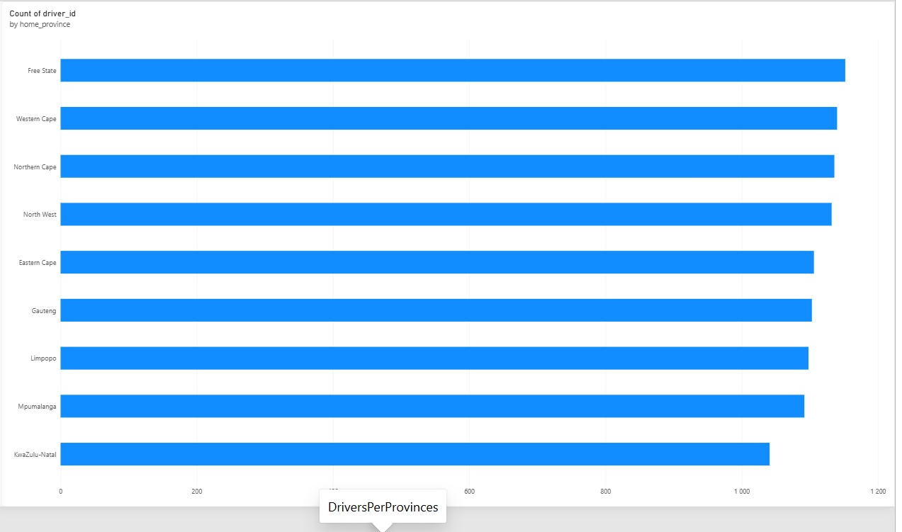
Drivers each province
Drivers are distributed across all South African provinces.
The distribution is relatively balanced.
No province dominates the workforce.
Key Insight:
  Driver allocation appears evenly spread across provinces.

Slide 16
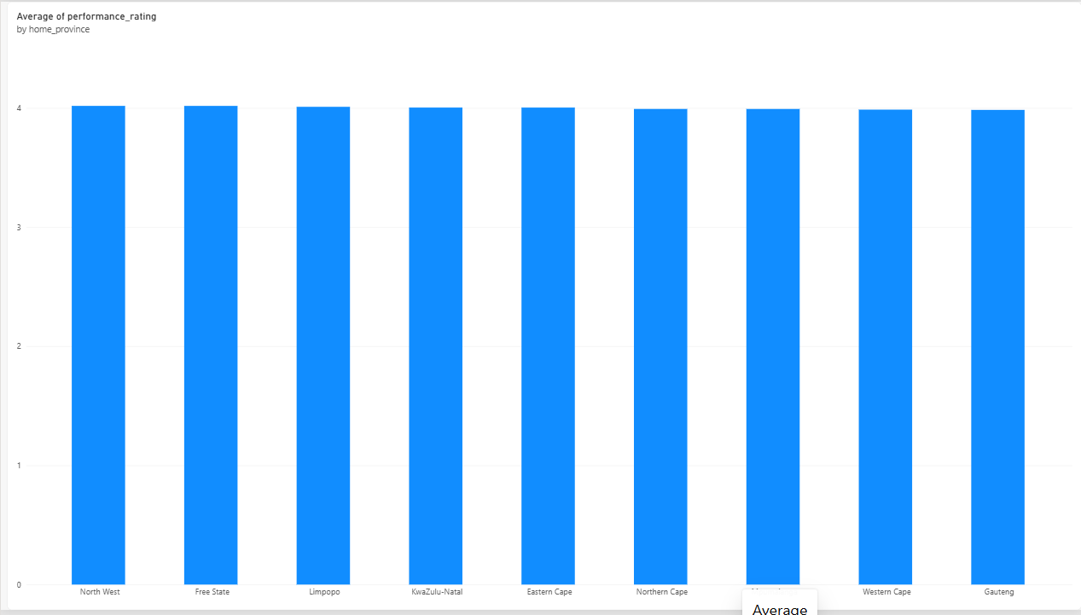
Performance rating per province
Performance ratings are consistent across provinces.
No major performance gaps are visible.
Drivers achieve similar performance standards nationally.
Key Insight:
  Driver performance is stable regardless of province.

Slide 17
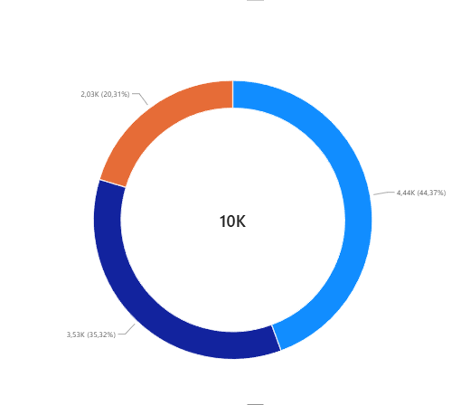
License Type distribution
Code 10 licenses represent the largest group.
Code 8 licenses form the second largest category.
Code 14 licenses are the smallest group.
Key Insight:
  Most drivers possess a Code 10 license.

Slide 18
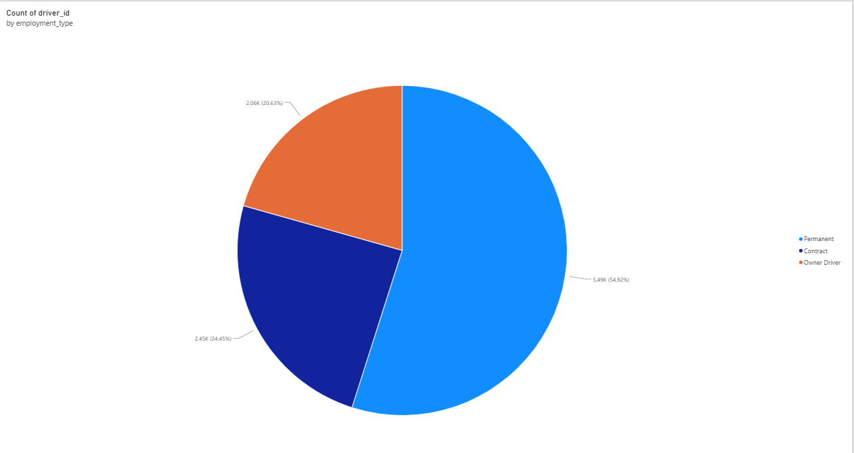
Employment Type Distribution
Permanent employees form the majority.
Contract drivers are the second-largest group.
Owner Drivers represent the smallest segment.
Key Insight:
  The company relies mostly on permanent drivers.

Slide 19
Experience vs Performance
Driver experience and performance are positively related.
More experienced drivers generally maintain strong ratings.
Training investments may improve long-term performance.
Key Insight:
  Experience contributes to stable driver performance.

Slide 20
Recommendations
Continue monthly monitoring of driver KPIs.
Maintain training and development initiatives.
Recruit according to license requirements.
Review employment mix periodically.
Use dashboard insights for operational decisions.

Slide 21
Delivery Risk & Business Intelligence
6th de

Slide 22
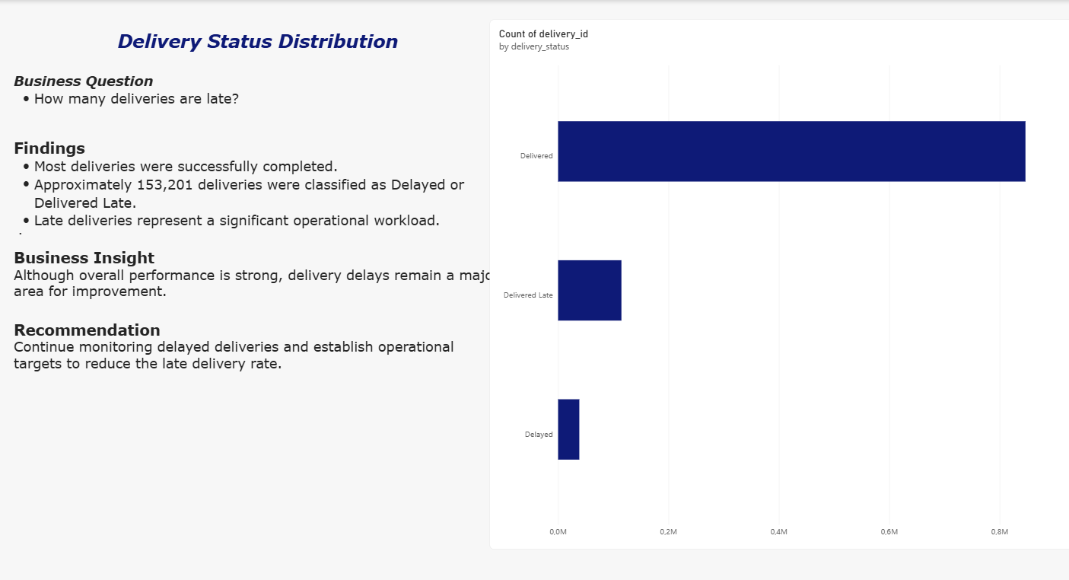
Delivery Status Distribution

Slide 23
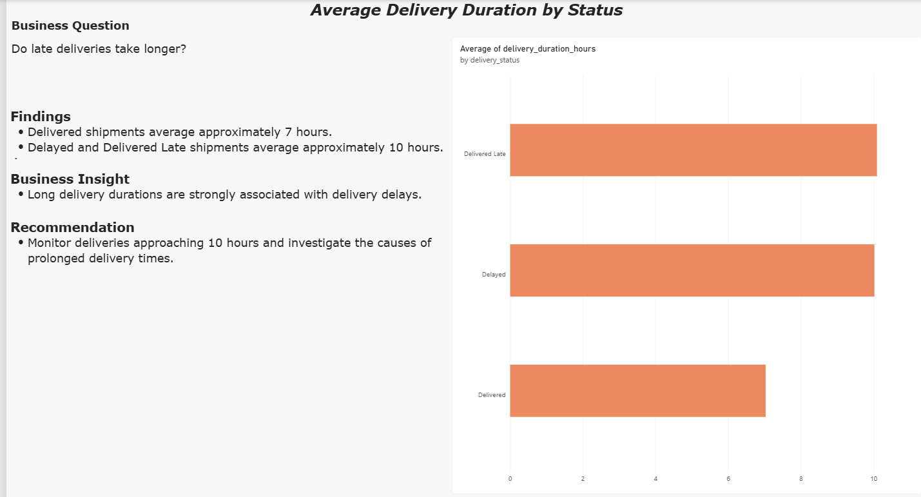
AVERAGE DELIVERY DURATION BY STATUS

Slide 24
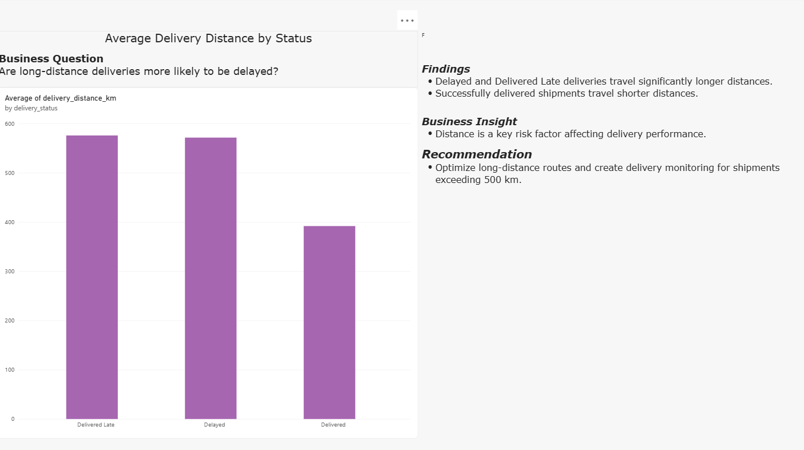
AVERAGE DELIVERY BY DISTANCE

Slide 25
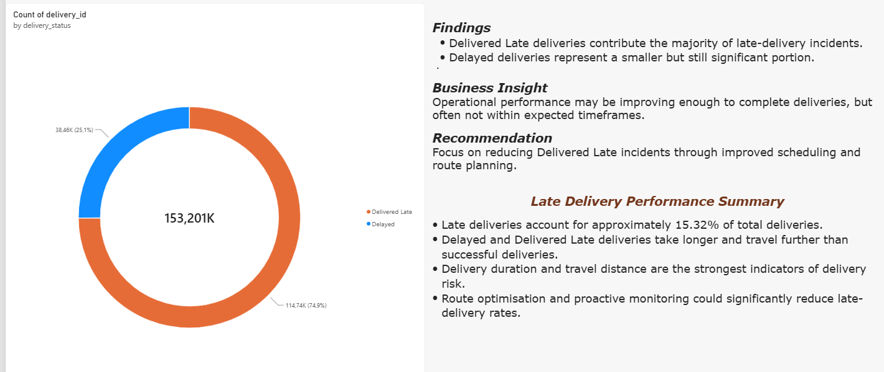
LATE DELIVERY SPLIT

Slide 26
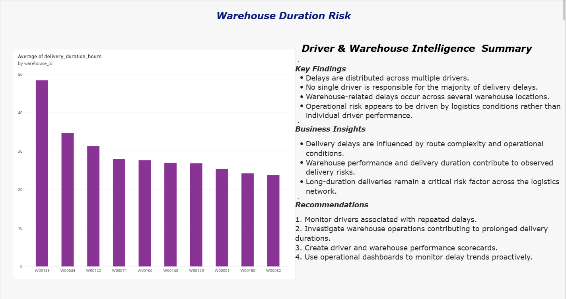
WAREHOUSE DURATION RISK

Slide 27
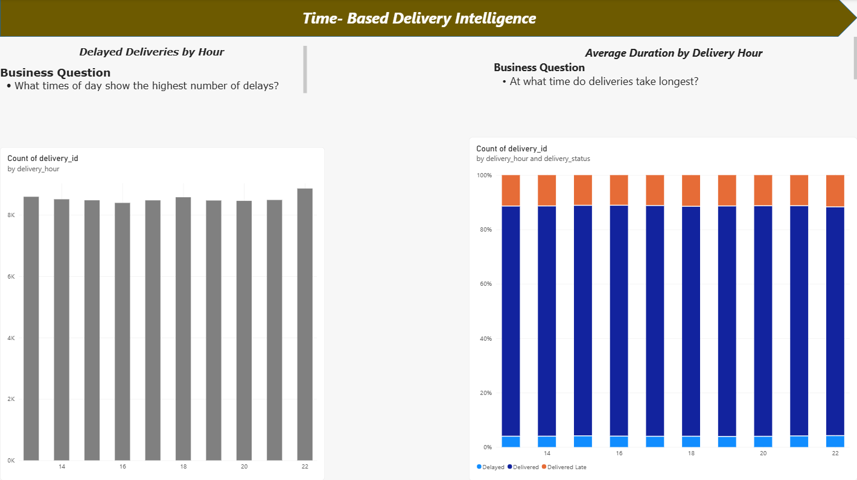
TIME-BASED DELIVERY INTELLIGENCE

Slide 28
Business Intelligence & Management Intelligence
Key Findings
Shipment volumes are heavily concentrated in Gauteng, creating operational bottleneck risks.
Delivery performance is affected by seasonal demand fluctuations and peak periods.
Power BI dashboards provide visibility into operational performance and supply chain risks.
Business Insights
Shipment concentration increases dependency on key regions.
Demand fluctuations highlight the need for improved capacity planning.
Data-driven monitoring enables proactive decision-making and risk mitigation.
Recommendations
Improve forecasting and capacity planning for peak demand periods.
Optimize route planning, fleet utilization, and resource allocation.
Use Power BI dashboards for continuous monitoring of KPIs and operational risks.
Conclusion
The Business Intelligence solution enables management to proactively monitor performance, identify operational risks, and make informed decisions. By improving planning, resource allocation, and operational visibility, the organization can build a more efficient and resilient supply chain.

Slide 29
Operational Risk Scoring
6th de

Slide 30
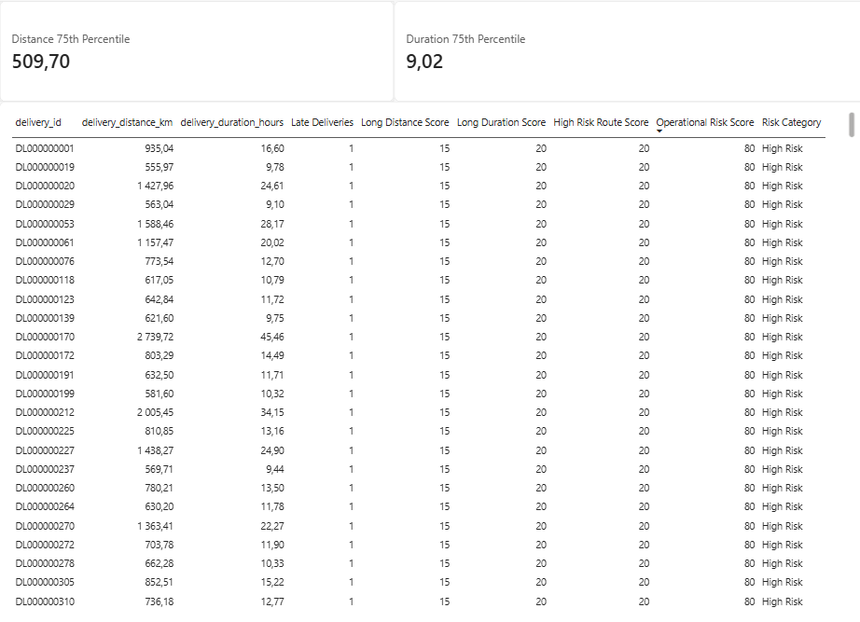
Risk Category
0–30 = Low Risk
31–60 = Medium Risk
61–100 = High Risk

Slide 31
Business Intelligence
Operations Questions
How many deliveries are late?
what percentage of deliveries are late?
which routes have the highest late-delivery rate?
which drivers have the highest delay rates?
which vehicles are associated with the most delays?
which warehouses have the highest operational risk?
what times of day show the greatest delivery delays?

Slide 32
Business intelligence
Operations
Late deliveries
The total number of late deliveries is 1147
11.47% of deliveries were delivered late.
3.85% deliveries of deliveries were delayed
Therefore a total of 15.32% of deliveries experienced delivery delays
Drive with high delay rates.
Driver D009690 currently has the highest delay rate in the dataset, recording 42 late deliveries, making this driver the primary focus for delay-reduction initiatives.
Vehicles associated with the most delays
Vehicles V002946, V003908, and V012633 are associated with the highest number of delayed deliveries in the dataset, making them priority candidates for operational and maintenance reviews to improve delivery performance.

Slide 33
Business Intelligence
Operations
Warehouses that have the highest operational risk.
The warehouses with the highest operational risk are W00011, W00017, W00029, W00035, W00052, W00061, W00057, W00096, and W00097, as they recorded the highest number of delayed deliveries in the dataset. These warehouses should be prioritized for further operational review and improvement initiatives.
Times of day that shows the greatest delivery delays.
10 PM (22:00) experiences the highest number of delayed deliveries, making it the time period with the greatest delivery delay risk. Management should investigate evening delivery operations to improve on-time delivery performance.

Slide 34
Business Intelligence
Management
Q8. What are the three biggest operational risks?
Shipment volumes are concentrated in a few provinces, especially Gauteng, creating a risk of operational bottlenecks.
Standard shipments dominate the business, meaning any disruption to standard delivery operations could affect a large percentage of customers.
Shipment activity changes over time, indicating a risk of resource under utilisation during quiet periods and capacity constraints during busy periods.
Q9. What should management investigate?
Management should investigate the causes of high shipment concentration in key provinces, analyse capacity requirements during peak business days, and identify the factors causing changes in shipment activity over time. Additional investigation should focus on delayed deliveries, route efficiency, vehicle utilisation and warehouse performance.
Q10. What operational controls could reduce delivery delays?
Improve route planning and scheduling.
Monitor driver and vehicle performance.
Increase staffing and fleet availability during peak periods.
Implement proactive vehicle maintenance.
Track delivery performance through real-time dashboards.

Slide 35
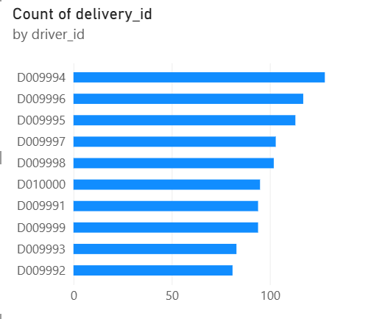
Q11. Drivers Requiring Management Attention
Q11. Drivers Requiring Management Attention
Finding
D009994, D009996, and D009995 handle the highest delivery volumes.
High workloads may increase the risk of delivery delays.
Recommendation
Review driver workloads and optimize route assignments to improve delivery performance.
  Management should monitor drivers D009994, D009996, and D009995, as they handle the highest delivery volumes and may be at greater risk of delivery delays.

Slide 36
Business Intelligence
Q12. How could the company improve customer satisfaction?
Reduce delivery delays.
Improve delivery predictability.
Focus resources on high-volume provinces.
Optimize delivery methods.
Improve communication with customers regarding shipment status.

Slide 37
THANK YOU

